Slide 1
Capstone project 1: House Prices: Advanced Regression Techniques
Grace Liu

Slide 2
Project Overview
Project Objective: Predicting housing prices based on the given features
Data description: With 79 explanatory variables describing (almost) every aspect of residential homes in Ames, Iowa
Other research questions:
1) How does the pricing differ by houses’ features?
2) Which features impact the housing price the most?
3) Does home-style make a difference in housing price given other features of the houses the same?
Audience of the analysis: Home Buyers, Home Builders, Housing Sales/Agents

Slide 3
Data Wrangling
Step1: Understanding the data, column types, data frame shape, correlation between variables.
Step2: Removing outliers
Step3: Combining the training set and test set to impute missing values
Step4: Adding features, Correcting features on the combined data set
Step5: Respliting the data set into training and test set

Slide 4
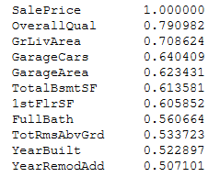
Examining the correlation between the features and the “sale price”
This correlation is based on the given features from the raw data with no features created yet.
Overall house quality, above grade living area, number of cars garage holds, garage area, total basement square feet, 1st floor square feet, full bathrooms above grade, total rooms above grade, year built and remodeled date are highly correlated with houses’ sale prices.

Slide 5
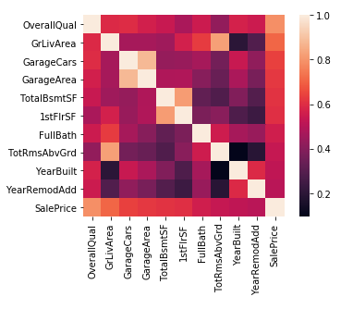
Which features are highly correlated?
Among the features that are strongly correlated with “Sales Prices”, the features below are highly correlated:
Total basement area and 1st floor area (0.81953)
Size of garage in Sf and Size of garage in car capacity (0.8824)
Total rooms above grade and living areas above grade(0.825489)

Slide 6
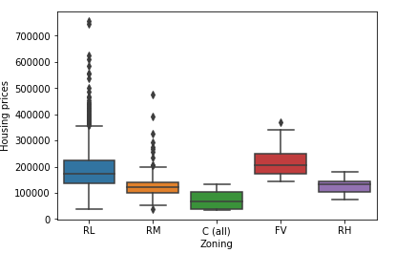
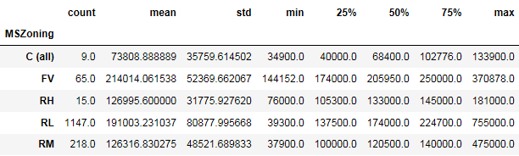
Housing price by MS Zoning
The figure shows the median value of housing price by the type of houses. As shown, the median housing price for "Floating Village Residential" is the highest. The next highest median housing price is "Residential low density", while the lowest median housing price is "Commercial". The boxplot presents that the housing price for "Floating Village Residential" is more dispersed. The least dispersed housing prices is the "Residential Medium Density".
Medium housing prices: FV>RL>RH>RM>C
Mean housing prices: FV>RL>RH>RM>C

Slide 7
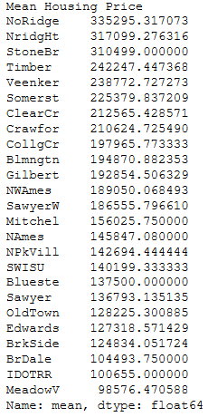
Housing price by neighborhood
On average, the most expensive neighborhood is “NoRidge”, “NridgHt”, “StoneBr”, “Timber” and “Veenker”.

Slide 8
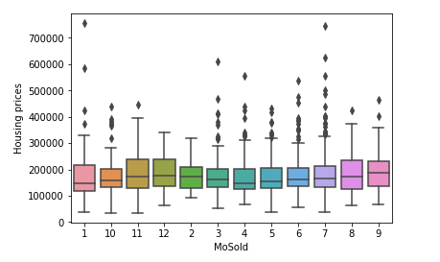
Housing price by month sold
The mean housing prices for houses sold in September and November are higher than the mean price of those sold in other months.
This difference in mean is statistically significant.

Slide 9
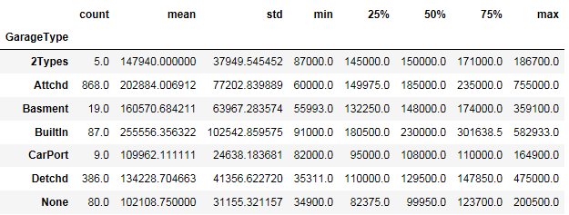
Housing price by garage types
Out of all the garage types, the building and attached garages have the higher mean housing price compared to the mean of houses with other types of garages.
The hypothesis testing shows that this difference in mean is statistically significant.

Slide 10
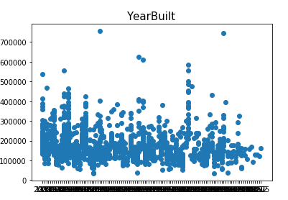
Correlation with other features and housing price
At different built year, the housing price ranges at all levels. Thus, the year when the houses were build is not a big factor explaining the housing prices.

Slide 11
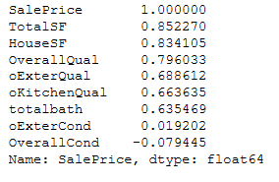
Correlation with other features and housing price
Housing prices is highly correlated with (absolute r>0.5) exterior quality, exterior condition, kitchen quality, house square feet, property square feet, total number of bathrooms, and overall quality. Specially the most correlated three features are total property square feet, house square feet and overall quality.
The correlation between the features and the housing price is statistically significant.

Slide 12
Preparation before the machine learning models
Converting categorical data into numeric data
Creating dummy variables for certain features
Transforming Dependent variable into normal distribution
Reducing Feature using PCA

Slide 13
Machine Learning Models
Machine learning models used are:
Linear Regression, Support Vector Regression, Gradient Boosting Tree, Lasso Regression, Ridge Regression, Bayesian Ridge Regression, Kernel Ridge Regression, Elastic Net Regularization
Models are evaluated using RMSE, models are ranked by accuracy below:
1. Kernel Ridge Regression
2. Bayesian Ridge Regression
3. Ridge Regression
4. Linear Regression
5. Elastic Net Regularization
6. Gradient Boosting Tree
7. Lasso Regression

Slide 14
Stacking models for prediction
Hyper-parameter tuning was done for the better perform models.
The seven models mentioned in the last slide were combined to create the stack model.
The accuracy score for the stack model is better than the accuracy score for the different models respectively.
Prediction was made using the stack model, and the result was submitted to Kaggle.

Slide 15
Suggestions
On average, the “NridgHt” neighborhood has higher housing prices comparing to the similar houses in other neighborhoods. It might be more profitable to sell houses in this neighborhood.
Basement area is positively correlated housing prices.
Number of stories and lot areas are not strong correlated with housing prices.

